Slide 2
Melanoma Detection on Dermoscopic Images using Superpixels Segmentation and Shape-Based Features
Diego Patiño, Alberto M. Ceballos-Arroyo, Jairo A. Rodriguez-Rodriguez, German Sánchez-Torres, John W. Branch-Bedoya
Departamento de Ciencias de la Computación y de la Decisión, Grupo de I+D en Inteligencia Artificial, Universidad Nacional de Colombia, Medellín, Colombia
Facultad de Ingenierías, Grupo de I+D en Sistemas y Computación, Universidad del Magdalena, Santa Marta, Colombia
* E-mails: dipaco@gmail.com, alceballosa@unal.edu.co, jaiarodriguezrod@unal.edu.co, gsanchez@unimagdalena.edu.co, jwbranch@unal.edu.co

Slide 3




Slide 4
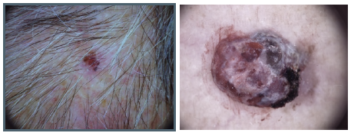
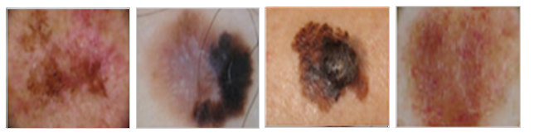
Melanoma
Melanoma is a kind of skin cancer which constitutes one of the main causes of skin cancer mortality. Each year, melanomas cause up to 66.000 deaths worldwide, including about 75% of skin cancer related deaths in Colombia (Pozzobon et al.,2018).
Benign lesion vs Melanoma (ISIC 2018)
Melanoma cases (ISIC 2018).

Slide 5
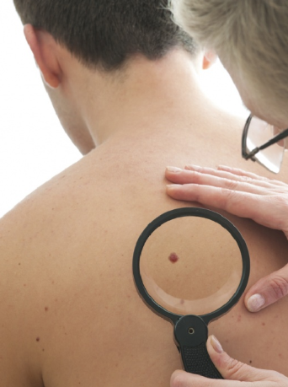
Lesion analysis: trad. approach
Traditionally, experts detect melanomas based on skin lesion features as per the ABCDE method: (A)symmetry, (B)order, (C)olor, (D)iameter (shape and size), and (E)valuation of evolution of the lesion over time (Tsao et al., 2015).
Notes:
This process is time-consuming, resulting in computational approaches being employed.

Slide 6
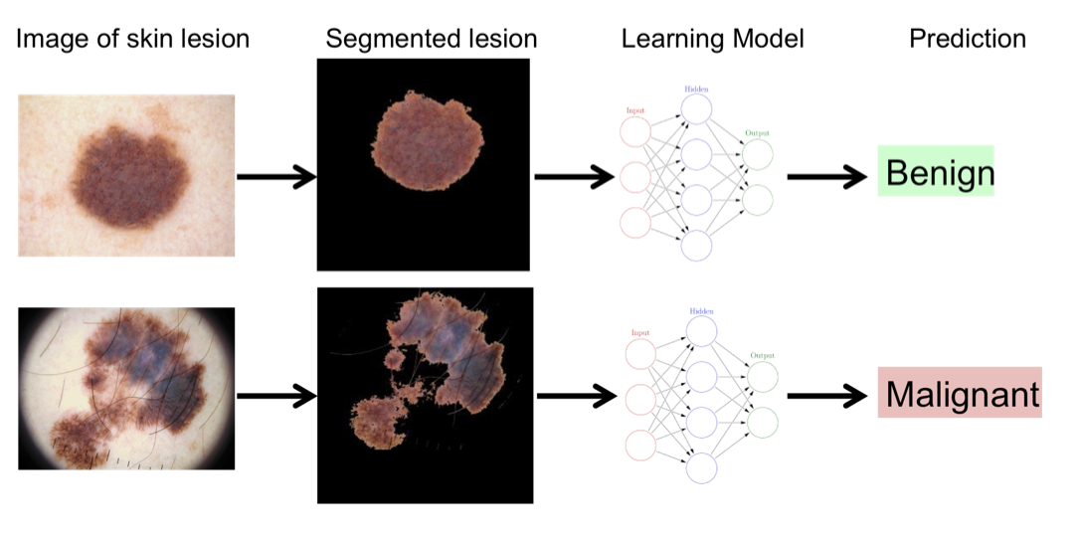
Computational approach
The first step for any melanoma detection pipeline is to segment the skin lesion, which is then classified as benign or malignant.
Computational pipeline for melanoma detection.

Slide 7
Proposal
We propose a computational pipeline for melanoma detection comprising segmentation and classification.
For this purpose, we first implemented a skin lesion segmentation algorithm based on super pixel merging and then we extracted shape, border and color features which were fed to three classification algorithms.
SLIC segmentation
Feature ext.:
-Border.
- Asymmetry.
-Color.
Classification:
-Log. reg.
-SVM.
-NN.
Greedy superpixel merging

Slide 8
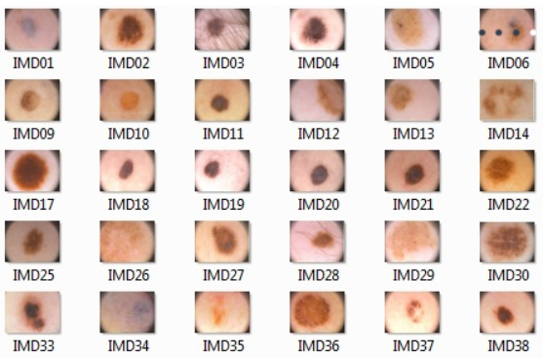
Dataset
We tested our methodology on the PH2 dataset, which consists of 200 images divided into three groups: common lesions, atypical nevi, and melanomas.
Some sample skin lesions from the PH2 dataset (Mendonca et al., 2013)

Slide 9
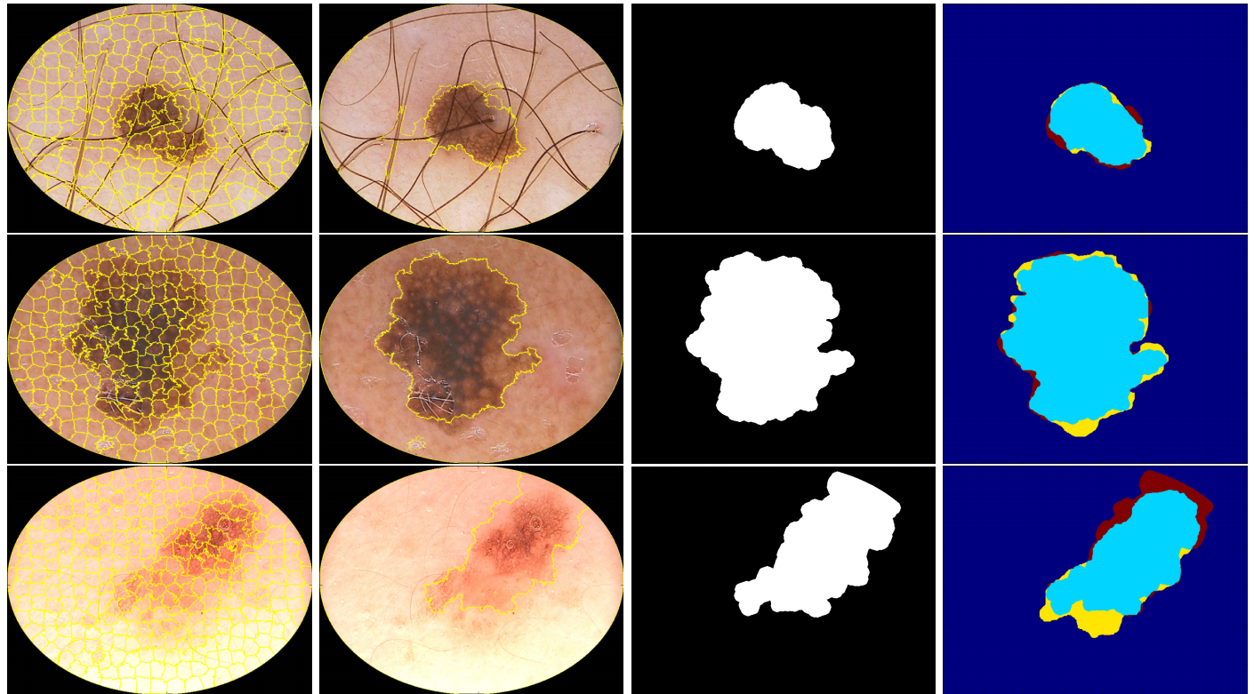
Segmentation
First, we use SLIC algorithm to obtain an over-segmentation of the original dermoscopic image I. Later, we greedily merge all of the k = 400 superpixels into two regions: lesion and healthy skin.
SLIC segmentation
Merged
superpixels
Ground truth mask
Seg. comparison
FN
TP
FP
Notes:
For segmenting the skin lesion from the whole image, our method performs a SLIC superpixel segmentation on the RGB dermoscopic images. Ideally, in the over-segmented image, the superpixel’s boundary should match partially the boundary of the object that is intended to segment

Slide 10
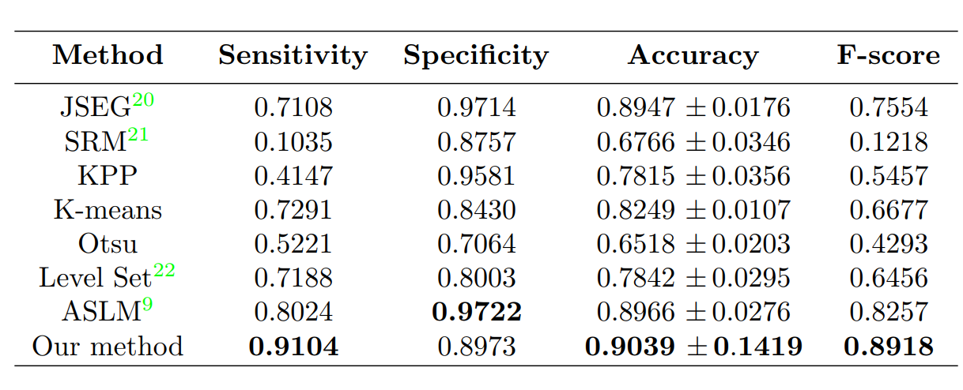
Segmentation results
20: Zhao, 2001; 21: Boltz, 2010; 22: Crandal, 2000; 9: Pennini et al., 2016.
Notes:
For segmenting the skin lesion from the whole image, our method performs a SLIC superpixel segmentation on the RGB dermoscopic images. Ideally, in the over-segmented image, the superpixel’s boundary should match partially the boundary of the object that is intended to segment

Slide 11
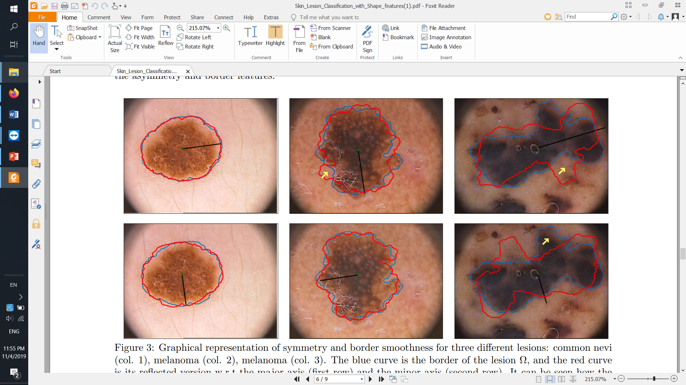
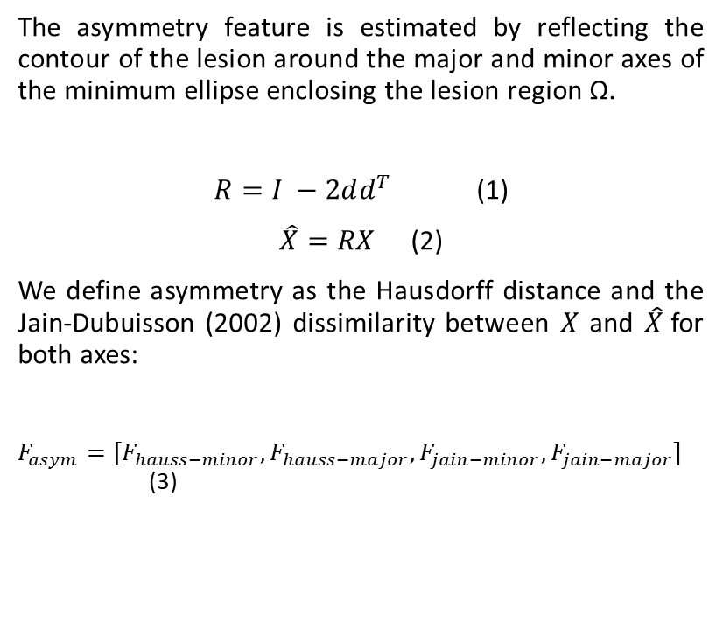
Feature extraction: asymmetry
The asymmetry feature is estimated by reflecting the contour of the lesion around the major and minor axes of the minimum ellipse enclosing the lesion region Ω.
$R=I −2dd^{T}$ (1)
$\hat{X}=RX$ (2)
We define asymmetry as the Hausdorff distance and the Jain-Dubuisson (2002) dissimilarity between $X$ and $\hat{X}$for both axes:
$F_{asym}=[F_{hauss−minor},F_{hauss−major},F_{jain−minor},F_{jain−major}]$ (3)
Notes:
For segmenting the skin lesion from the whole image, our method performs a SLIC superpixel segmentation on the RGB dermoscopic images. Ideally, in the over-segmented image, the superpixel’s boundary should match partially the boundary of the object that is intended to segment

Slide 12
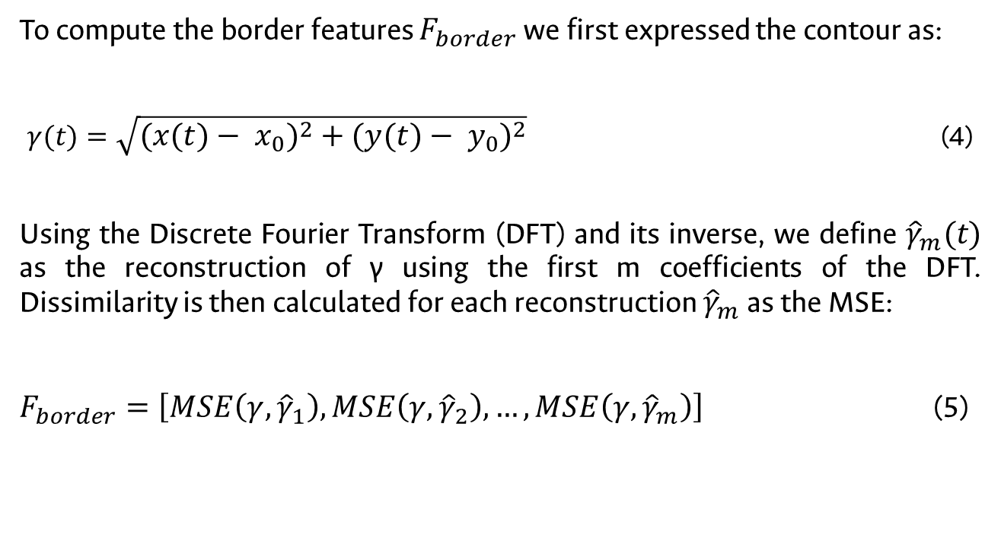
Feature extraction: border
To compute the border features $F_{border}$we first expressed the contour as:
$γ(t)=\sqrt{{\left(x\left(t\right)− x_{0}\right)}^{2}+{\left(y\left(t\right)− y_{0}\right)}^{2}}$ (4)
Using the Discrete Fourier Transform (DFT) and its inverse, we define ${\hat{γ}}_{m}(t)$ as the reconstruction of γ using the first m coefficients of the DFT. Dissimilarity is then calculated for each reconstruction ${\hat{γ}}_{m}$ as the MSE:
$F_{border}=\left[MSE\left(γ,{\hat{γ}}_{1}\right),MSE\left(γ,{\hat{γ}}_{2}\right), …,MSE\left(γ,{\hat{γ}}_{m}\right)\right]$ (5)
Notes:
For segmenting the skin lesion from the whole image, our method performs a SLIC superpixel segmentation on the RGB dermoscopic images. Ideally, in the over-segmented image, the superpixel’s boundary should match partially the boundary of the object that is intended to segment

Slide 13
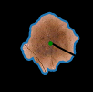
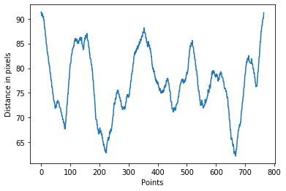
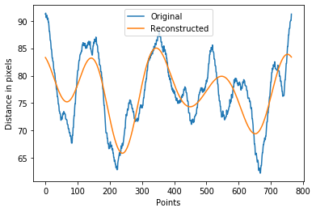
Feature extraction: border
Notes:
For segmenting the skin lesion from the whole image, our method performs a SLIC superpixel segmentation on the RGB dermoscopic images. Ideally, in the over-segmented image, the superpixel’s boundary should match partially the boundary of the object that is intended to segment

Slide 14
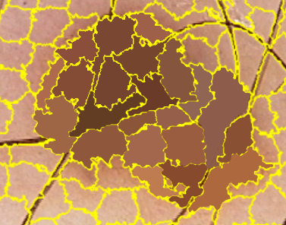
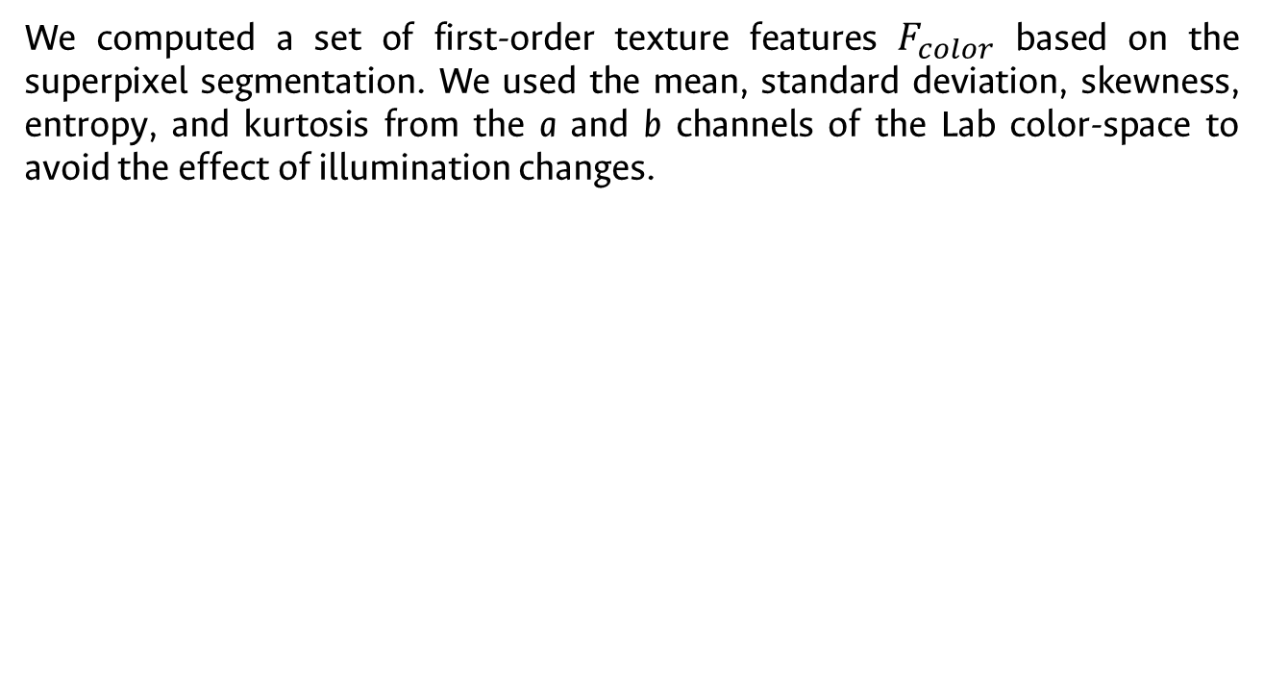
Feature extraction: color
We computed a set of first-order texture features $F_{color}$ based on the superpixel segmentation. We used the mean, standard deviation, skewness, entropy, and kurtosis from the a and b channels of the Lab color-space to avoid the effect of illumination changes.
Notes:
For segmenting the skin lesion from the whole image, our method performs a SLIC superpixel segmentation on the RGB dermoscopic images. Ideally, in the over-segmented image, the superpixel’s boundary should match partially the boundary of the object that is intended to segment

Slide 15

Classification
We used three classifiers:
- Logistic regression.
- Support vector machine.
- A neural network based on the
Fully connected layer of VGG16.
We tested using 10-fold cross validation (90/10 partition).
We report mean accuracy, precision, recall, and F1-score.
Trained with three sets of features:
A set of classic features (first-order color descriptors and hu moments).
Our set of proposed features.
A mix of classic and our proposed features.
Notes:
For segmenting the skin lesion from the whole image, our method performs a SLIC superpixel segmentation on the RGB dermoscopic images. Ideally, in the over-segmented image, the superpixel’s boundary should match partially the boundary of the object that is intended to segment

Slide 16
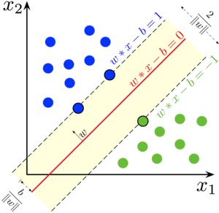
Classification
We used three classifiers:
- Logistic regression.
- Support vector machine.
- A neural network based on the
Fully connected layer of VGG16.
We tested using 10-fold cross validation (90/10 partition).
We report mean accuracy, precision, recall, and F1-score.
Trained with three sets of features:
A set of classic features (first-order color descriptors and hu moments).
Our set of proposed features.
A mix of classic and our proposed features.
Notes:
For segmenting the skin lesion from the whole image, our method performs a SLIC superpixel segmentation on the RGB dermoscopic images. Ideally, in the over-segmented image, the superpixel’s boundary should match partially the boundary of the object that is intended to segment

Slide 17

Classification
We used three classifiers:
- Logistic regression.
- Support vector machine.
- A neural network based on the
Fully connected layer of VGG16.
We tested using 10-fold cross validation (90/10 partition).
We report mean accuracy, precision, recall, and F1-score.
Trained with three sets of features:
A set of classic features (first-order color descriptors and hu moments).
Our set of proposed features.
A mix of classic and our proposed features.
VGG16 network (Simonyan and Zisserman, 2014).
Notes:
For segmenting the skin lesion from the whole image, our method performs a SLIC superpixel segmentation on the RGB dermoscopic images. Ideally, in the over-segmented image, the superpixel’s boundary should match partially the boundary of the object that is intended to segment

Slide 18
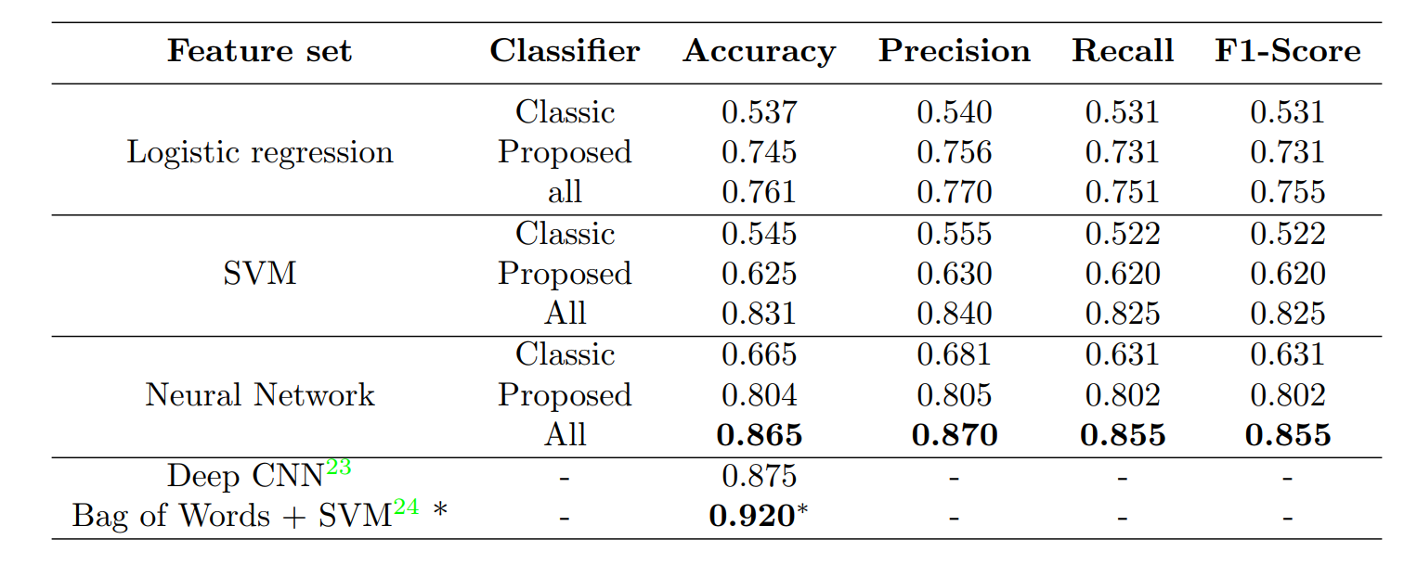
Classification results
23: Salido and Conrado, 2018. 24: Bi et al., 2016.
Notes:
For segmenting the skin lesion from the whole image, our method performs a SLIC superpixel segmentation on the RGB dermoscopic images. Ideally, in the over-segmented image, the superpixel’s boundary should match partially the boundary of the object that is intended to segment

Slide 19
Conclusions
In this work, we proposed a new set of shape and super-pixel-inspired features for skin lesion detection, which allow us to describe objects of interest based on asymmetry and border irregularities.
For both segmentation and classification, our methods gets close to the performance of deep learning algorithms on the small PH2 dataset while requiring less computational resources.
Notes:
For segmenting the skin lesion from the whole image, our method performs a SLIC superpixel segmentation on the RGB dermoscopic images. Ideally, in the over-segmented image, the superpixel’s boundary should match partially the boundary of the object that is intended to segment

Slide 20
Future work
Future work will focus on adjusting the merging criterion during segmentation to deal with cases where the lesion has more that one unconnected region. Regarding classification, a future work direction is to employ second-order texture features to better represent the color structure the lesions.
Additionally, the use of methods to reduce class imbalance could lead to significant improvement of the results.
Notes:
For segmenting the skin lesion from the whole image, our method performs a SLIC superpixel segmentation on the RGB dermoscopic images. Ideally, in the over-segmented image, the superpixel’s boundary should match partially the boundary of the object that is intended to segment

Slide 21
References
- Bi, L., Kim, J., Ahn, E., Feng, D., Fulham, M., Medicine, N., Prince, R., and Hospital, A., “Automatic Melanoma Detection via Multi-scale Lesion-biased Representation and Joint Reverse Classification,” in [2016 IEEE 13th International Symposium on Biomedical Imaging (ISBI) ], 1055–1058 (2016). –
- Boltz, S., “SRM method implementation,” (2010). http://www.mathworks.com/matlabcentral/fileexchange/authors/73145
- Crandall, R., “Level set implementation,” (2000). https://github.com/rcrandall/ChanVese
- Canfield Scientific, “ISIC Challenge 2018,” 2018. [Online]. Available: https: //challenge2018.isic-archive.com
- Dubuisson, M.-P. and Jain, A., “A modified Hausdorff distance for object matching,” in [Proceedings of 12th International Conference on Pattern Recognition], 1 (1), 566–568, IEEE Comput. Soc. Press (2002). 5
-Mendonça, Teresa & Ferreira, Pedro & Marques, Jorge & Marçal, André & Rozeira, Jorge. (2013). PH2 - A dermoscopic image database for research and benchmarking. Conference proceedings : ... Annual International Conference of the IEEE Engineering in Medicine and Biology Society. IEEE Engineering in Medicine and Biology Society. Conference. 2013. 5437-5440. 10.1109/EMBC.2013.6610779.
-Tsao, H., Olazagasti, J. M., Cordoro, K. M., Brewer, J. D., Taylor, S. C., Bordeaux, J. S., Chren, M.-M.,Sober, A. J., Tegeler, C., Bhushan, R., and Begolka, W. S., “Early detection of melanoma: Reviewing the abcdes,” Journal of the American Academy of Dermatology 72 (4), 717 – 723 (2015).
-C. Pozzobon, Á. E. Acosta, and J. S. Castillo, “Cáncer de piel en Colombia: cifras del Instituto Nacional de Cancerología,” Revista de la Asociación Colombiana de Dermatología y Cirugía Dermatológica , vol. 26, no. 1, pp. 12–17, 2018. [Online]. Available: https://revista.asocolderma.org.co/index.php/asocolderma/article/view/25
-Salido, J. A. A. and Conrado Ruiz, J., “Using Deep Learning for Melanoma Detection in Dermoscopy Images,” International Journal of Machine Learning and Computing 8 (1), 61–68 (2018).
- Simonyan, K., & Zisserman, A. (2014). Very deep convolutional networks for large-scale image recognition. arXiv preprint arXiv:1409.1556.
Zhao, Q., “JSEG method implementation,” (2001). cs.joensuu.fi/zhao/Software/JSEG.zip
Notes:
For segmenting the skin lesion from the whole image, our method performs a SLIC superpixel segmentation on the RGB dermoscopic images. Ideally, in the over-segmented image, the superpixel’s boundary should match partially the boundary of the object that is intended to segment

Slide 22


Director:
John Willian Branch Bedoya
Investigador Senior
Facultad de Minas - Departamento de Ciencias de la Computación y de la Decisión
Universidad Nacional de Colombia – Sede Medellín
Correo: jwbranch@unal.edu.co

Slide 23


Director:
German Sánchez Torres. Ph.D.
Investigador Senior
Facultad de Ingenierías - Ingeniería de Sistemas
Universidad del Magdalena
Tel: 018000 516060 Ext: 1138 / Cel: 3016836593
Ed. Docente Cub. 3D102
Correo: gsanchez@unimagdalena.edu.co - sanchez.gt@gmail.com

Slide 24
Thank you!
Notes:
For segmenting the skin lesion from the whole image, our method performs a SLIC superpixel segmentation on the RGB dermoscopic images. Ideally, in the over-segmented image, the superpixel’s boundary should match partially the boundary of the object that is intended to segment

